Slide 1

Team SEWZ: Project report
Shouyu Ling, Eric Chang, Wei Shao, Zorry Belchev

Slide 2
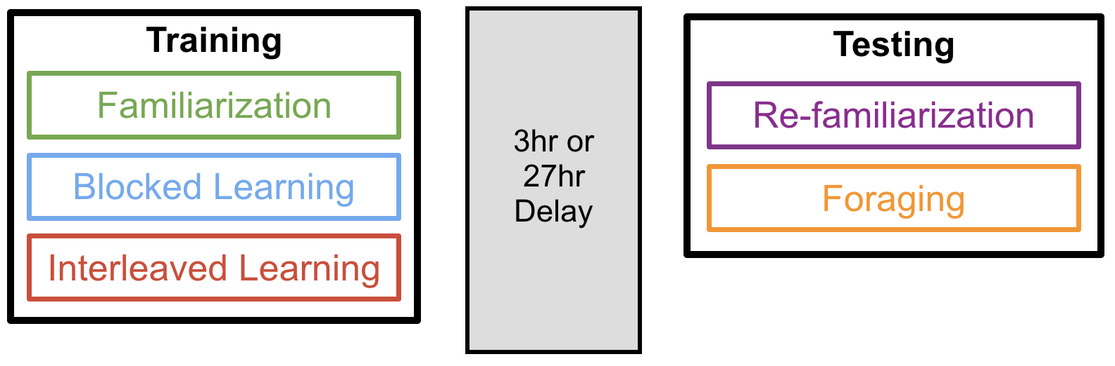
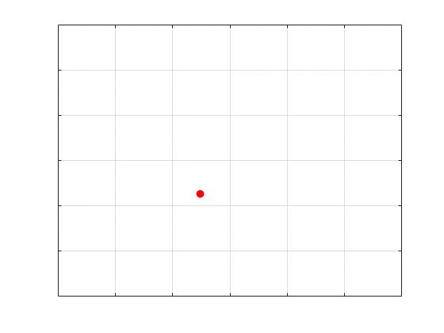
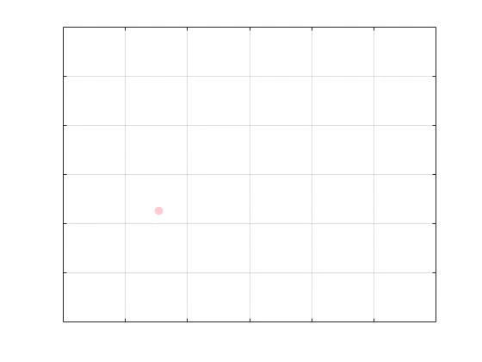
Experiment overview: Training Phase
Blocked Learning
Interleaved Learning

Slide 3
Experiment overview: Training Phase

Slide 4
Goals
Do participants learn during the training phase (i.e., does performance improve over training blocks)?
Do they remember the locations of rewards in testing? What factors influence their memory?
Can we predict their performance in the testing phase by how they perform in the training phase?

Slide 5
Predict performance on Block 3
Regression model based on invisible trials
Block 3 Performance
Block 2 Performance
Environment Type
Rural
Urban
Reward Type
Food
Water
Money

Slide 6
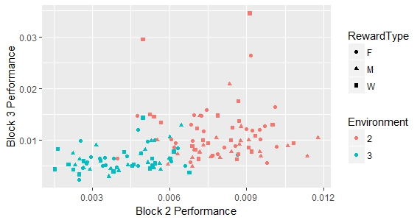
Predict performance on Block 3
Regression model : Results
REML criterion at convergence: -1079.9
Variable | F | p
Block2Performance | 0.69 | .41
Environment | 13.87 | .0003
RewardType | 2.12 | .12
Rural
Urban

Slide 7
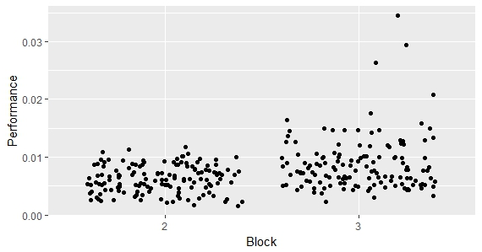
Does performance improve from Block 2 to 3?
Follow-up ANOVA across environment & reward type
Performance ~ Block (2, 3)
Variable | F | p
Block | 32.32 | <.0001
Performance improves across training blocks

Slide 8
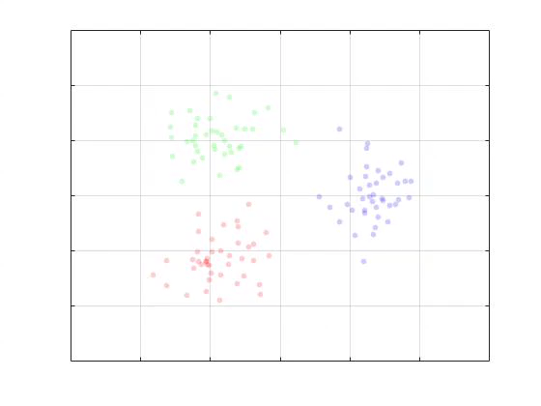
Example: A Good Subject

Slide 9
Example: A Good Subject

Slide 10
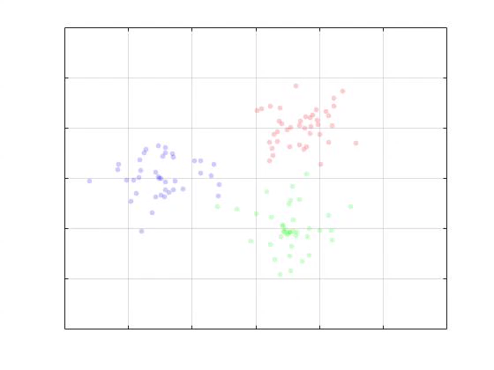
Example: A Bad Subject

Slide 11
Example: A Bad Subject

Slide 12
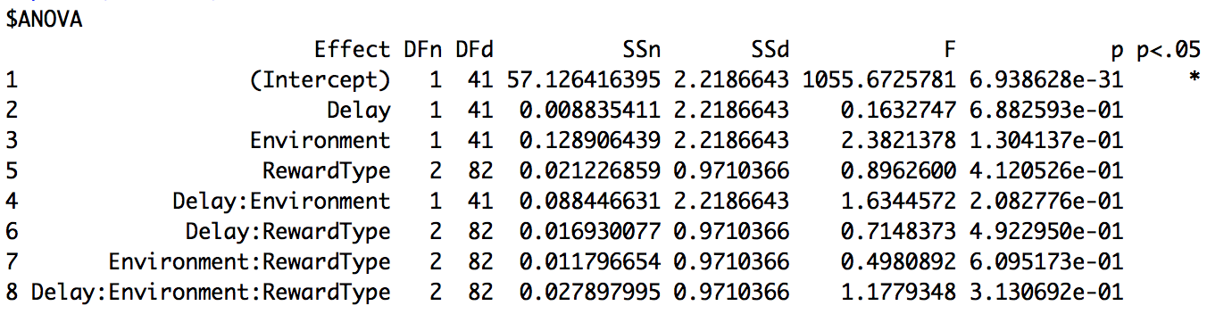
Three-way mixed-design ANOVA
Dependent variable: Bhattacharyya Coefficient
Independent variables:
Between-subject: Delay (Short, Long) and Environment (Rural, Urban)
Within-subject: Reward Type (Food, Water, Money)

Slide 13
Effect of the environment & delay

Slide 14
Predict Testing Performance
Number of rewards found during the training
r = .62, p < .001

